Slide 1
Lesson objective
PBiS focus
Respect – listening
Learn – complete all tasks
Title: Special angles
Aim:
To be able to identify and describe complementary and supplementary angles.
Plan:
Daily review: identifying angles
Estimating angles
Exploring types of angles
Calculators and whiteboards

Slide 2


Daily review
Identify: Obtuse, acute or reflex

Slide 3
These are the angle facts we have learned so far:
Use the degrees at the bottom to fill in the missing words.
An acute angle is less than _____
An obtuse angle is less than ______ and more than _____
A right angle is _____
A reflex angle is less than ______ and more than ______
Angles on a straight line add up to _______
Angles in a triangle add up to ________
90°
180°
90°
180°
360°
90°
180°
90°
180°
360°
180°

Slide 4
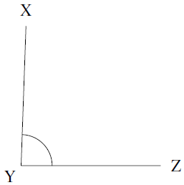
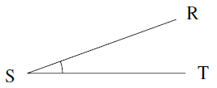
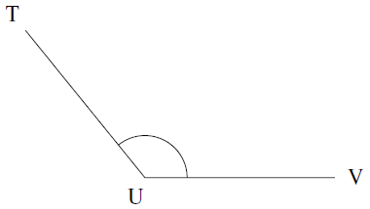
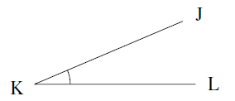
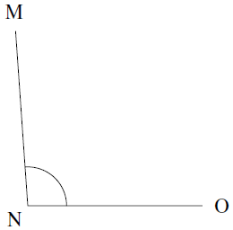
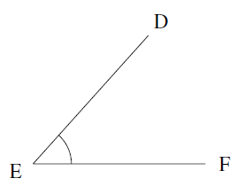
Guess the size of the angles:
Scoring:
  ±10º = 1 point
  ±5º = 3 points
  ±1º = 5 points
  Exact = 10 points
1
2
88º
20º
23º
129º
48º
94º
4
3
How did you do?
Up to 6 – ok
Up to 15 – good
Up to 20 – great
Up to 30 – awesome
Over 30 – legend
6
5

Slide 5
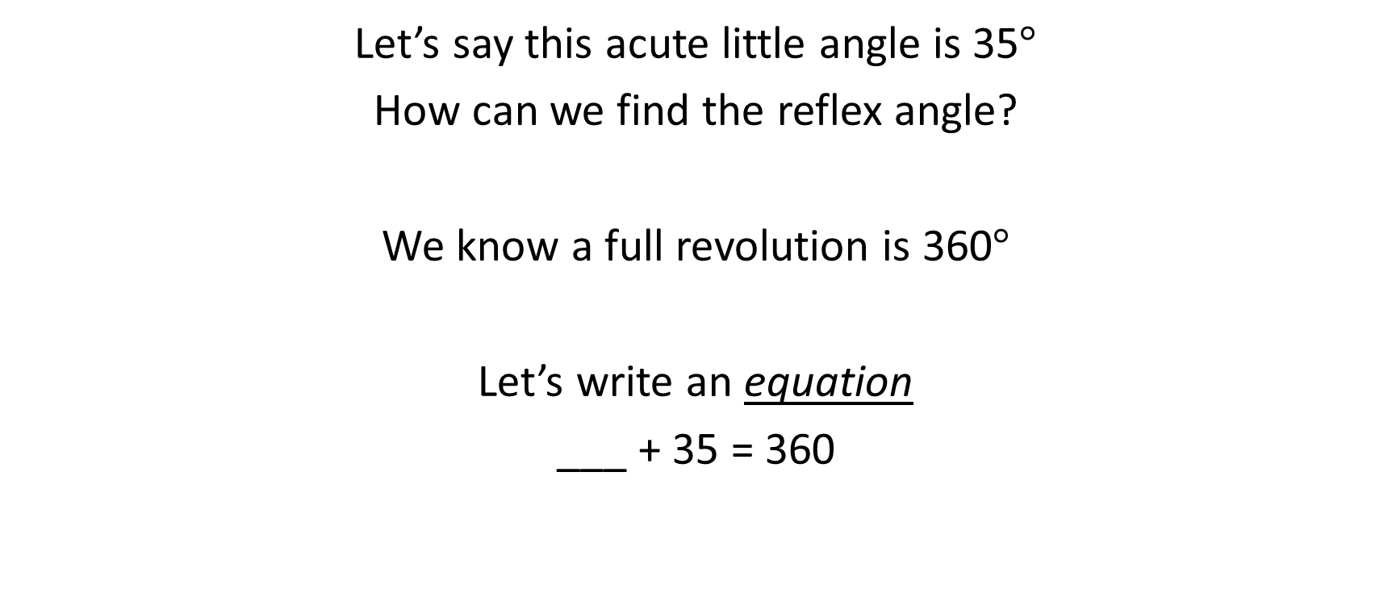
Using equations to find angles
Let’s say this acute little angle is 35$°$
How can we find the reflex angle?
We know a full revolution is 360$°$
Let’s write an equation
___ + 35 = 360
X

Slide 6




Another one
80$°$
x$°$

Slide 7



Whiteboards
Write an equation and solve the unknown angle.
x$°$
300$°$

Slide 8



Whiteboards
Write an equation and solve the unknown angle.
270$°$
x$°$

Slide 9




Whiteboards
Write an equation and solve the unknown angle.
x$°$
120$°$

Slide 10



Whiteboards
Write an equation and solve the unknown angle.
x$°$
86$°$

Slide 11
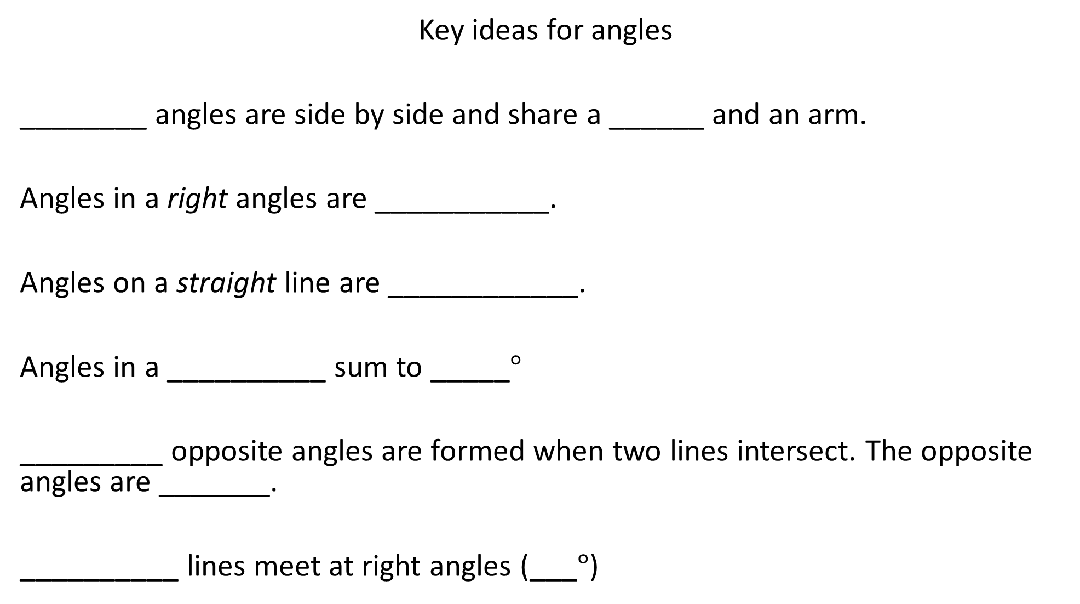
Key ideas for angles
________ angles are side by side and share a ______ and an arm.
Angles in a right angles are ___________.
Angles on a straight line are ____________.
Angles in a __________ sum to _____$°$
_________ opposite angles are formed when two lines intersect. The opposite angles are _______.
__________ lines meet at right angles (___$°$)
Adjacent
Vertex
Complementary
How many degrees in a right angle?
How many degrees in a straight line?
Supplementary
Revolution
360
Vertically
Equal
Perpendicular
90

Slide 12
Key ideas for angles
________ angles are side by side and share a ______ and an arm.
Angles in a right angles are ___________.
Angles on a straight line are ____________.
Angles in a __________ sum to _____$°$
_________ opposite angles are formed when two lines intersect. The opposite angles are _______.
__________ lines meet at right angles (___$°$)
How many degrees in a right angle?
How many degrees in a straight line?

Slide 13
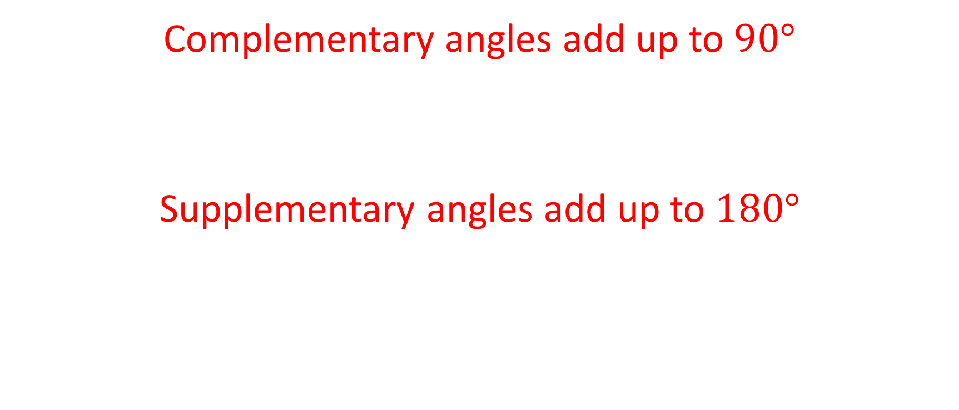
Choral response
Complementary angles add up to $90°$
Supplementary angles add up to $180°$

Slide 14
Whiteboards ready!
Complementary angles add up to ______
Supplementary angles add up to _______
Vertically opposite angles are e_______

Slide 15
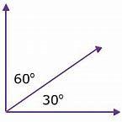
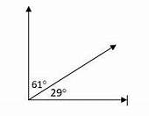
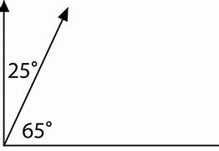
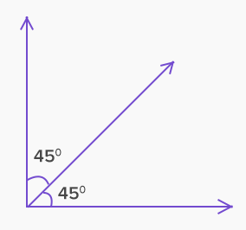
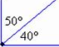
Complementary Angles add up to 90º
Which is not a pair of complementary angles?
x
31º
60º
??

Slide 16
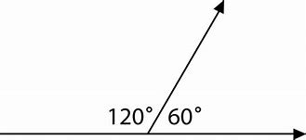
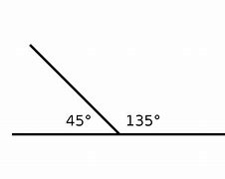

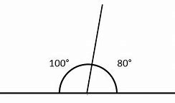
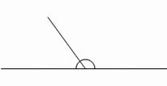

Supplementary Angles add up to 180º
^{Which is not supplementary?}
x
40º
140º
100º
??
81º

Slide 17
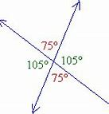
Vertically Opposite angles are Equal
140º
152º
40º
40º
28º
28º
140º
152º
x
150º
120º
30º
30º
60º
59º
150º
121º

Slide 18



Whiteboards
Complementary angles add up to $90°$
Write an equation and solve the unknown angle.
x$°$
30$°$

Slide 19



Whiteboards
Complementary angles add up to $90°$
Write an equation and solve the unknown angle.
75$°$
x$°$

Slide 20


Whiteboards
Complementary angles add up to $90°$
Write an equation and solve the unknown angle.
15$°$
x$°$

Slide 21


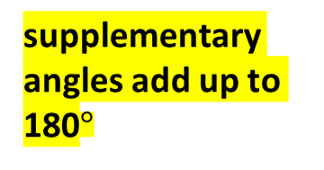
Whiteboards
supplementary angles add up to 180$°$
Write an equation and solve the unknown angle.
140$°$
x$°$

Slide 22


Whiteboards
supplementary angles add up to 180$°$
Write an equation and solve the unknown angle.
70$°$
x$°$

Slide 23


Whiteboards
supplementary angles add up to 180$°$
Write an equation and solve the unknown angle.
95$°$
x$°$

Slide 24




Whiteboards
Vertically opposite angles are equal.
Solve the unknown angles x and y.
100$°$
y$°$
80$°$
x$°$

Slide 25



Whiteboards
Vertically opposite angles are equal.
Solve the unknown angles x and y.
x$°$
y$°$
40$°$
140$°$

Slide 26



Whiteboards
Vertically opposite angles are equal.
Solve the unknown angles x, y and z.
supplementary angles add up to 180$°$
130$°$
y$°$
z$°$
x$°$

Slide 27




Whiteboards
Vertically opposite angles are equal.
Solve the unknown angles x, y and z.
supplementary angles add up to 180$°$
150$°$
y$°$
z$°$
x$°$

Slide 28
Individual practice
Complete the task sheet provided.

Slide 29
Fist to five
Aim:
To be able to identify and describe complementary and supplementary angles.

Slide 30



Whiteboards
supplementary angles add up to 180$°$
Write an equation and solve the unknown angle.
55$°$
45$°$
x$°$

Slide 31


Whiteboards
supplementary angles add up to 180$°$
Write an equation and solve the unknown angle.
x$°$
x$°$
x$°$

